Slide 1
Scientific Computation and Data Visualization, Part 3
Link to this document
Applied Python

Slide 2
What are we doing?
Learning Objectives
By the end of this session, you should:
understand the process of data wrangling.
identify the key steps in transforming data from its raw form into a target form.
know how to deal with missing values, both numeric and categorical.
Measurable Outcomes
By the end of this session, you should be able to:
gather up data into a DataFrame.
analyze a DataFrame for malformed data.
drop columns and rows in a Dataframe.

Slide 3
DATA TYPES

Slide 4
Types of data
Generally, there are three classifications of how data are organized:
Cross Sectional Data
Time Series Data
Panel Data

Slide 5
Cross Sectional Data
Cross sectional data are data from multiple sources during one time period. Examples include:
The final grade of all students in this class during one semester
The number of riders of each ride at an amusement park last Tuesday
The US census (or any other state census, for that matter)

Slide 6
Time Series Data
Time series data are data from a single source during multiple time periods. Examples include:
The number of students enrolled in this class every semester for the last three years.
The number of people at an amusement park every day in the last 12 months.

Slide 7
Panel Data
Panel data are a combination of both cross sectional and time series: data from multiple sources during multiple time periods. Examples include:
The final grades of students enrolled in all classes during every semester for the last three years.
The number of riders of each ride at an amusement park every day in the last 12 months.

Slide 8
DATA WRANGLING

Slide 9
Big data and you
Given that you live in the era of big data, let's talk about data.
Data is messy. It might:
come from several sources.
contain data that isn't relevant to your project.
be missing values.
contain wild outliers or other discrepancies.

Slide 10
Data wrangling: nothing is perfect
If you want to work with a dataset, then, what do you do? If it's messy, how do you clean it up?
Data wrangling refers to the process of transforming your data - which could contain any of the above issues - into a usable format.

Slide 11
Wrangling process
The data wrangling process is multistep. but believe it or not, you've already been doing this informally. It's just going to be formalized this week. The process is simple:
Collect the data into one place.
Select the desired attributes and records.

Slide 12


Context: Titanic
April 15, 1912, during her maiden voyage, the widely considered “unsinkable” RMS Titanic sank after colliding with an iceberg.
Unfortunately, there weren’t enough lifeboats for everyone onboard, resulting in the death of 1502 out of 2224 passengers and crew.

Slide 13
Wrangling step 1: gather the data
The first step in the data wrangling process is to actually collect all the data you want to use!
You already know how to do this.
import pandas as pd
def main():
# import the file
file_path = 'titanic.csv'
df_titanic = pd.read_csv(file_path)
if __name__ == '__main__':
main()

Slide 14
Wrangling step 2: select attributes
Once you've got the data collected up, you're going to want to do a little bit of analysis. The first part of this analysis is: what data do you even want to use?
This can be done either by a quantitative analysis or a qualitative inspection of the data. In future weeks, you'll learn how to do this quantitatively. For now, recognize that evaluating qualitatively means using domain-specific knowledge.

Slide 15
Coding Challenge
Coding Challenge:
Analyze the DataFrame and get rid of the data you don't want, leaving only the desired data remaining. Take a qualitative approach.

Slide 16
Attribute selection: solution 1
The plan:
show the info of the DataFrame
qualitatively analyze the columns
select the columns to keep
def main():
# ... previous code goes here
# show information about the DataFrame
print(df_titanic.info())
# Pclass, Sex, and Age will likely contribute to the state
# of the Survived attribute, so keep those
df_titanic = df_titanic[ ['pclass', 'sex', 'age', 'survived'] ]
if __name__ == '__main__':
main()

Slide 17
Attribute selection: solution 2
The plan:
show the info of the DataFrame
qualitatively analyze the columns
remove the unwanted columns
def main():
# ... previous code goes here
# show information about the DataFrame
df_titanic.info()
print(df_titanic.describe())
# Pclass, Sex, and Age will likely contribute to the state
# of the Survived attribute, so drop everything else
df_titanic = df_titanic.drop(columns=['name', 'sibsp', 'parch', 'ticket', 'fare', 'cabin', 'embarked', 'boat', 'body', 'home.dest'])
if __name__ == '__main__':
main()

Slide 18
Wrangling step 2: select records
What is called "selecting records" here is really a several sub-step process. Records could be messy in a number of ways:
Duplicate records could exist.
Values could have been entered incorrectly - i.e. malformed - on some records.
Values could be missing from records.
There could be records which contain values far away from the rest of the dataset; outliers.

Slide 19
Wrangling: duplicates
There may be times when there are identical records in a dataset; typically you'll want to remove the duplicates so that you don't end up training with the same data more than once!
To do this with pandas, simply use the .drop_duplicates() method:
df = df.drop_duplicates()
There is certainly some nuance here, however: what actually constitutes a duplicate? It is worth noting that it's probably appropriate to check for and remove duplicates when there is as much information as possible, i.e. before selecting attributes.

Slide 20
Wrangling: malformed
Data can be malformed in all sorts of ways. Examples include but are not limited to:
one alphabetic character in a column meant to be numeric; importing it will cause the entire column to become string data.
incorrect categorical information, such as a third category for a binary attribute (e.g. 'yes', 'no', and 'peter'.
Dealing with malformed data, therefore, requires you to evaluate each column individually for discrepancies, using your domain specific knowledge.
# ... previous code goes here
def main():
# ... previous code goes here
# show information about the DataFrame
df_titanic.info()
print(df_titanic.describe())
# make sure each categorical attribute has the correct number
# of unique values in it
print(df_titanic.nunique())
# make sure the unique values make sense
for column in df_titanic.columns:
print(column, df_titanic[column].unique())
# if there is any malformed data, filter it out!
if __name__ == '__main__':
main()

Slide 21
Wrangling: missing values
Once you've slimmed down the DataFrame so that it only contains the attributes you want, the next step is to check to see if there are any missing values and deal with them accordingly.
In this course, you'll be dropping any record that has a missing value. Note that what's actually happening here is a process called imputation.
def main():
# ... previous code goes here
# various ways to show missing values
print(df_titanic.isnull().any()) # True for a column if there are any NaNs in it
print(df_titanic.isnull().sum()) # counts all of the Trues in each column
print(df_titanic.isnull().sum()/df_titanic.shape[0]*100) # gives the % of missing
# drop all rows with any NaNs in them
df_titanic = df_titanic.dropna(axis=0)
if __name__ == '__main__':
main()
Note: It’s a best practice to dropna() AFTER you down select your columns

Slide 22
Missing values: drop observation
That axis=0 kwarg is important. what happens if you change:
df_titanic = df_titanic.dropna(axis=0)
to this?:
df_titanic = df_titanic.dropna(axis=1)

Slide 23
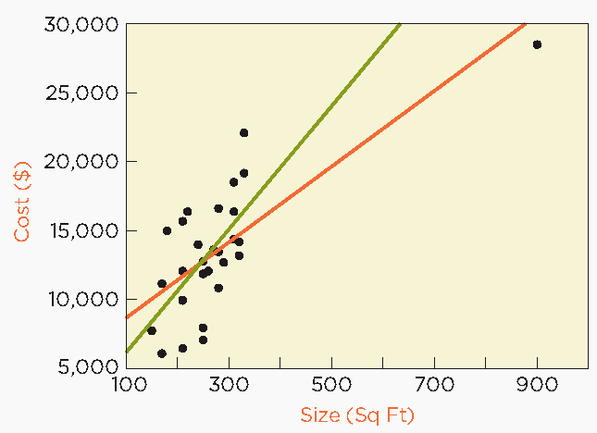
Wrangling: outliers
Outliers potentially skew your data analysis. For example:
A contractor is bidding on a project to construct an 875 square foot addition to a home. How much do they bid?
The addition of the point at approx. (900, 28,000) changes the trendline to something that no longer fits the rest of the data as well.

Slide 24
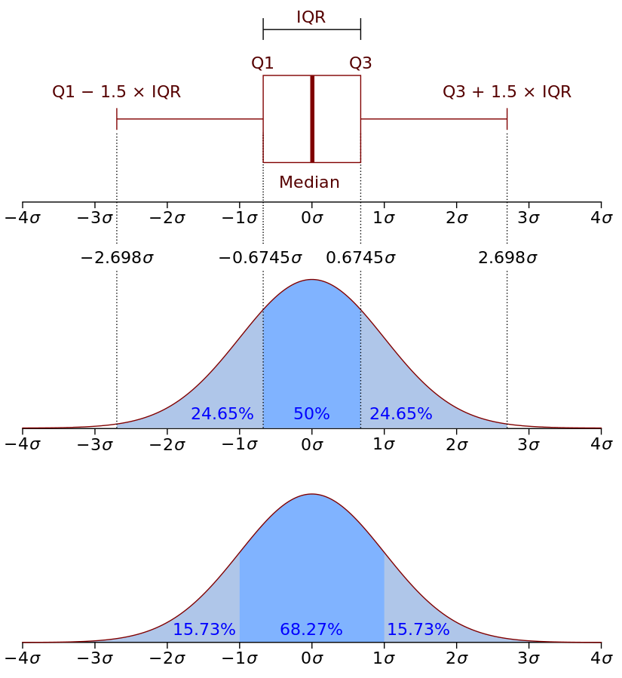
Outliers: many approaches
There are many approaches to defining and identifying outliers. The one you'll use in this class is via the interquartile range; this technique is also called Tukey's fences. (Note that this approach assumes a standard distribution!)
More importantly, however: what the heck is that plot on the top?

Slide 25
Outlier identification: boxplots
In order to visualize and identify outliers, you're going to need to understand (and use!) a new type of plot: the box plot. The box plot, like the histogram, visualizes the distribution of the data:
The median is the midpoint of the distribution
Q1 and Q3 represent the midpoints of the lower and upper halves of the dataset, respectively.
The IQR, or the InterQuartile Range, represents the range from Q1 to Q3. It is 50% of the dataset.
Those vertical lines at the far left and right of the horizontal lines are the minimum and maximum values considered to still be within acceptable range; anything above or below are deemed outliers. These lines are also called whiskers.

Slide 26
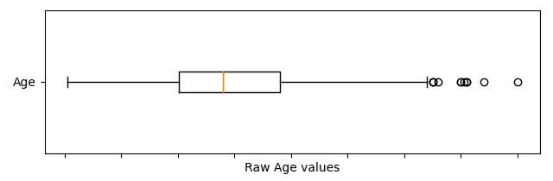
Coding Challenge
Coding Challenge:
Now that you've gotten a good idea of what the anatomy of a boxplot is, create one which shows the Age data from the Titanic dataset. (You can see the outliers on the plot - they are shown as circle markers.)

Slide 27
Outliers: boxplot solution
The plan:
create a Figure with two Axes
extract the Age data and create a boxplot with it
add labelling
save the Figure
def main():
# ... previous code goes here
# create and plot a boxplot of Age
fig, ax = plt.subplots(1, 1, sharex=True)
ax.boxplot(df_titanic['age'], tick_labels=['age'], vert=False)
# style and save figure
ax.set(xlabel='Raw Age values')
fig.suptitle('Titanic dataset: visualizing Age outliers')
fig.tight_layout()
fig.savefig('titanic_analysis.png')
if __name__ == '__main__':
main()

Slide 28
Outliers: let them lie
It's worth noting that there are several approaches to dealing with outliers once you've defined and identified them. One of the approaches - the one you'll be taking in this course - is the following:
Unless explicitly asked to do so, just leave them there - don't even bother finding them.
Ultimately, they may skew your data analysis, but you won't know until you actually do the analysis. So keep 'em for now!

Slide 29
Summary of terms
Terminology:
Data type:
Cross Sectional
Time Series
Panel
Data wrangling:
Collect data
Select records and attributes
box plot
outliers
Interquartile range
dropping
specific terminology/syntax:
DataFrame.drop_duplicates()
DataFrame.drop()
DataFrame.isna()
DataFrame.dropna()

